Slide 2
Introduction to Actor Model through Akka.nEt

Slide 3


Bart Lannoeye
Glenn Versweyveld
Senior .NET Consultant @ Sirus
Twitter: @bartlannoeye
Mobile Developer @ Bank J.Van Breda & C°
Twitter: @depechie

Slide 4
What is the Actor Model?
Abstraction that allows to code in terms of communication
Is inherently concurrent
Is implemented thread safe (in Akka.NET)
And thus very scalable
Everything is an actor
Manages concurrency through messages and encapsulation
It’s a different mindset!
Notes:
Communication: think ‘command’ part of CQRS: send commands and trust the system it will be handled.
Encapsulation: an actor can only change state internally and all logic is hidden from the outer world.

Slide 5
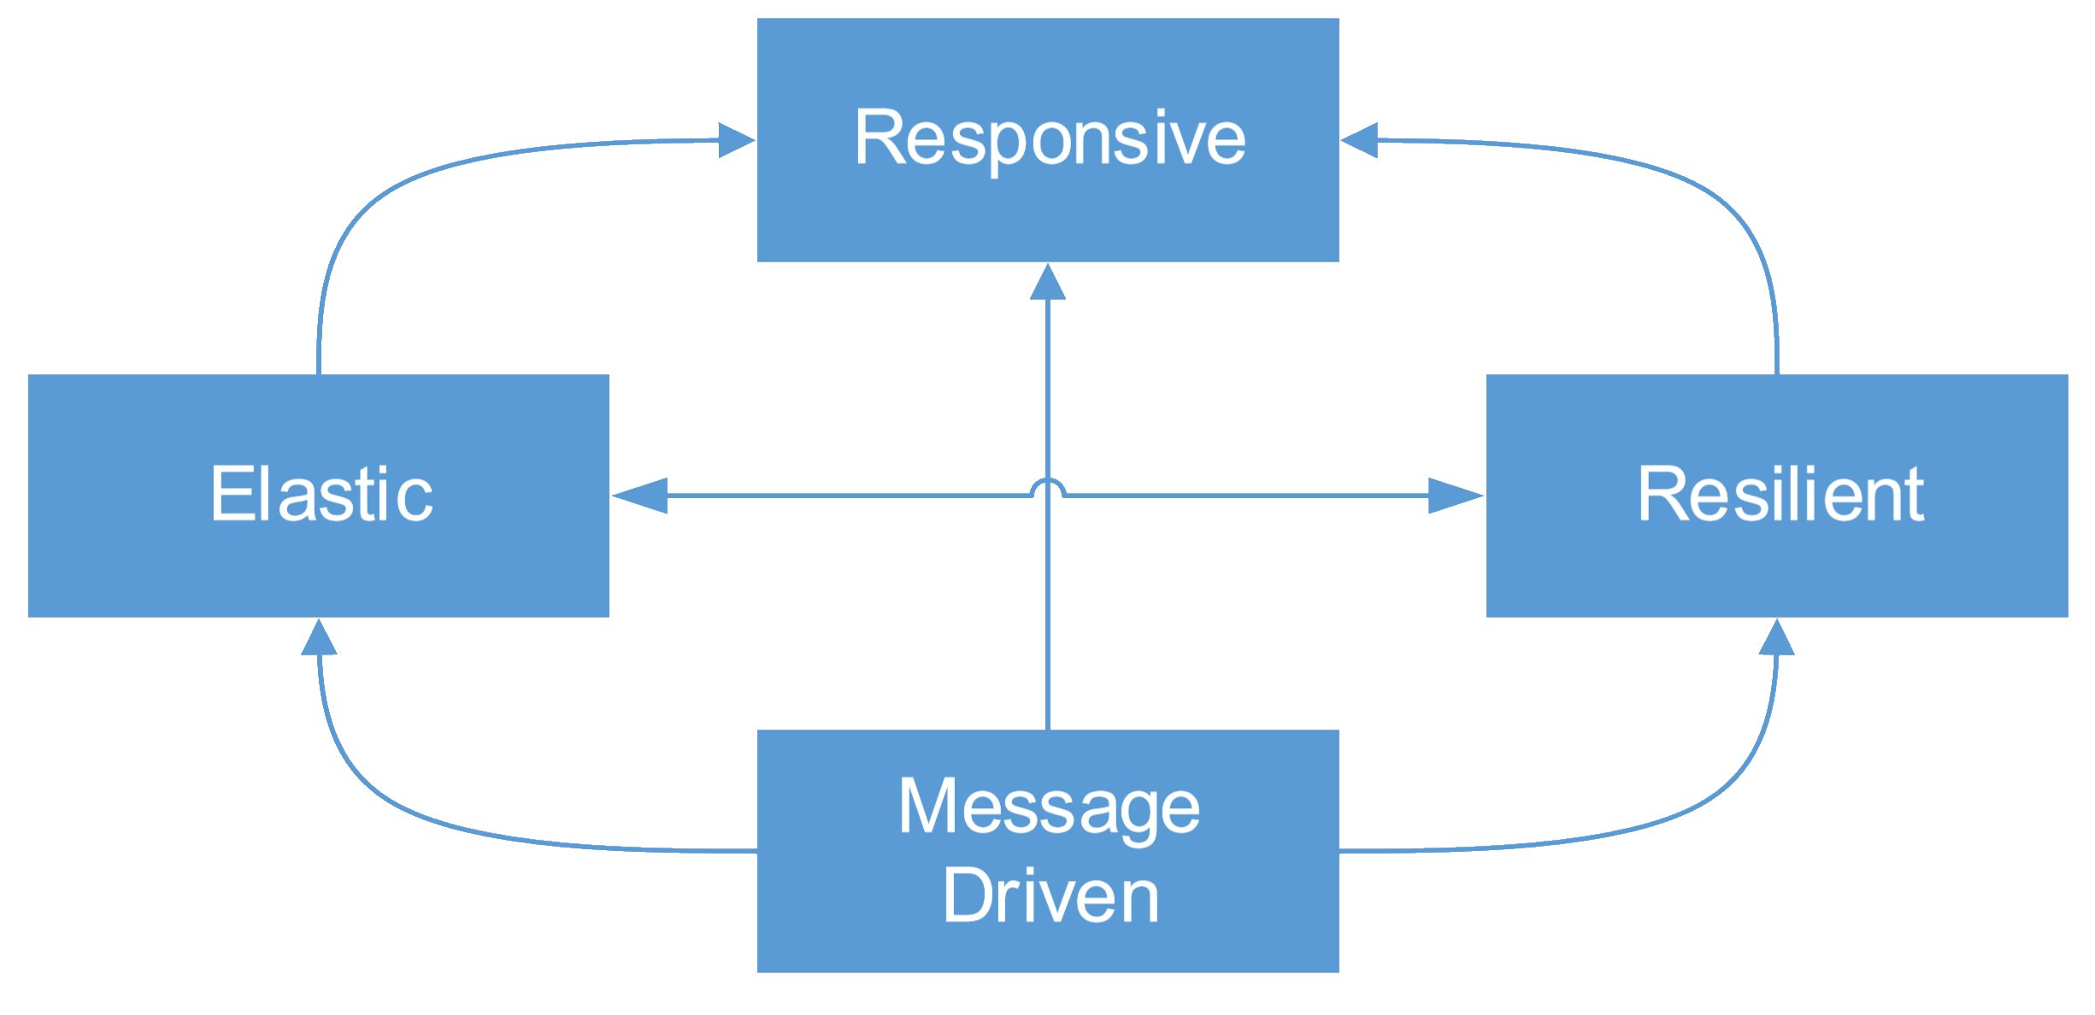
What is Akka.NET?
Port of Java/Scala Akka
Open Source
Task Parallel Library
‘Reactive Manifesto’
Notes:
Responsive: system reponds in timely manner, with rapid & consistent response times
Resilient: stay responsive in face of failure. By replication, isolation, delegation, …
Elastic: (de)provision resources automatically: available resources matches current demand as closely as possible
No central bottlenecks
Message driven: Async message passing to ensure loose coupling, isolation and location transparency

Slide 6
What needs are solved with Akka.NET?
Multi-threaded behavior without the use of low-level concurrency constructs like atomics or locks.
Transparent remote communication between systems.
A clustered, high-availability architecture that is elastic, scales in or out, on demand.
Self-healing system with local and remote hierarchies.
High performance systems with small footprint
50 million messages per sec, ~2.5 million actors per GB

Slide 7

Notes:
Just kidding ☺ Too early for the closing party.

Slide 8
What is an Actor?
Lightweight
Never shares state
Communicates through async messages
Has a mailbox to buffer messages
Processes one message at a time
Is a single-threaded object

Slide 9
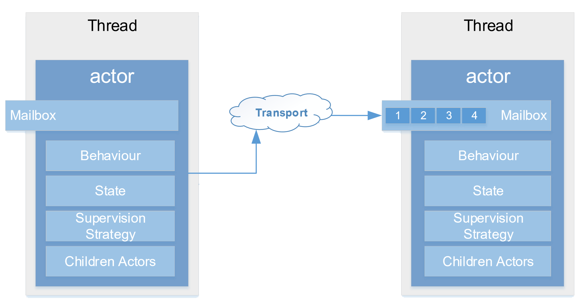
Actor message communication
Receive messages through UntypedActor / ReceiveActor

Slide 10
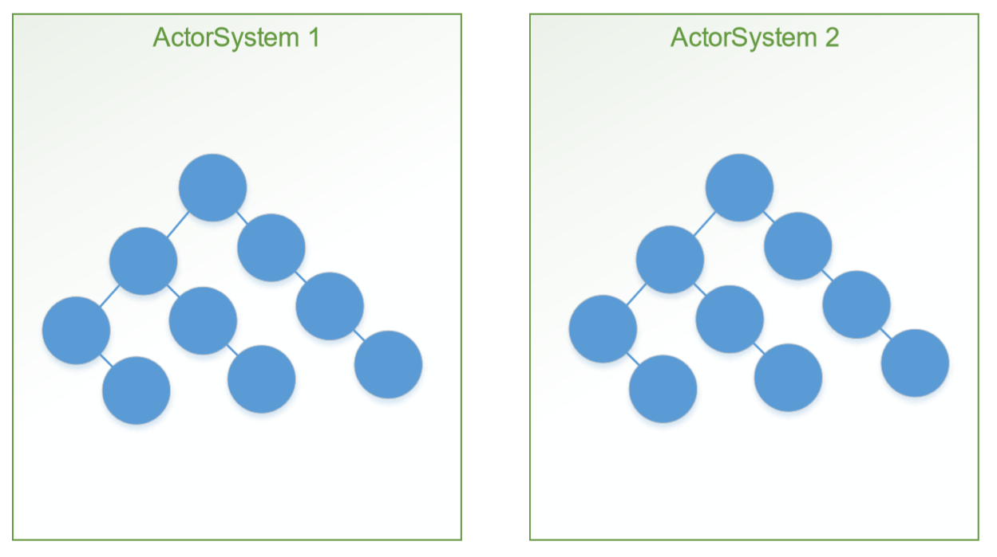
ActorSystem
Contained host hierarchy of actors
Manages configuration, threading, remoting, … of actors
Notes:
ActorSystem = expensive to create!

Slide 11
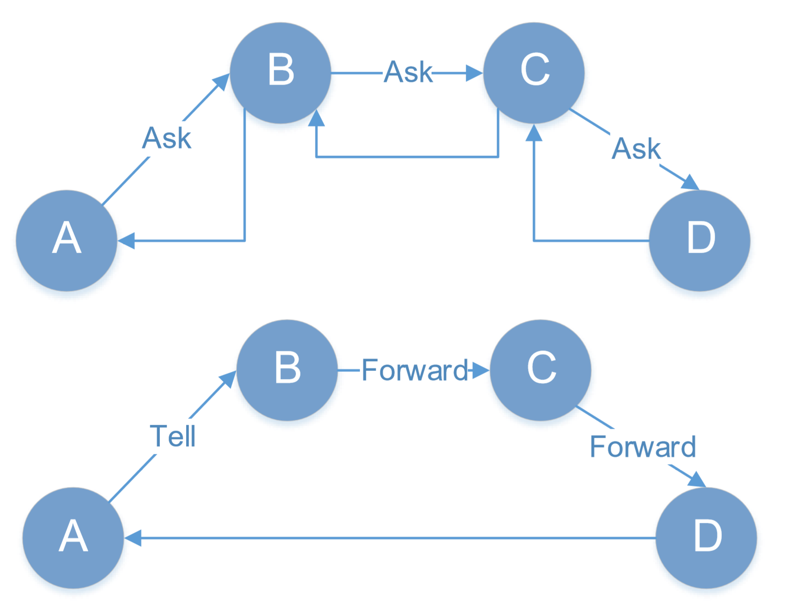
Sending messages
Message should be immutable
IActorRef: handle to Actor
Tell: fire-and-forget
Forward: Tell with sender info
Ask: request-response (expensive)
Solve by Tell and Forward

Slide 12
Demo: Sending our first message
Notes:
Demo 1:
Actor and messages
Actor system

Slide 13
Runtime behavior
Ability to act differently on messages depending on condition
If, then, else?
Switch to different message processor
Become()
BecomeStacked()
UnbecomeStacked()

Slide 14
Demo: Behaviors
Notes:
Demo 2: Behavior
- Play / Stop message

Slide 15
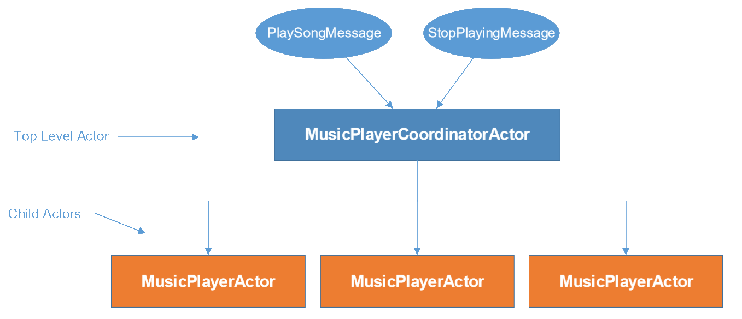
Actor Hierarchies
Root actor can create/own multiple child actors
Create through ActorContext instead of ActorSystem

Slide 16
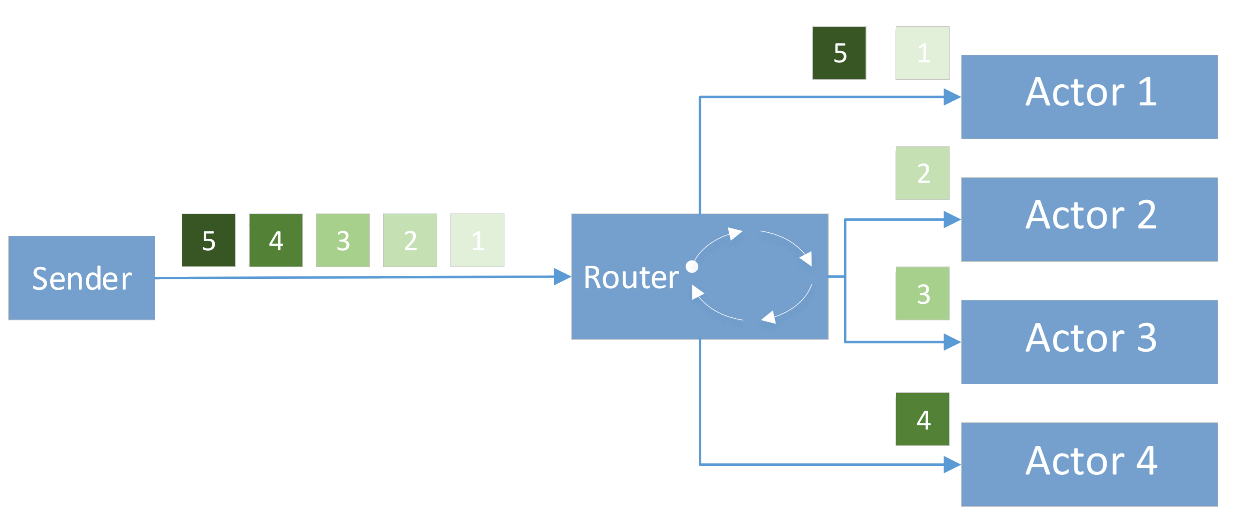
Routers
Special actor that groups other actors
Distribute message using strategy
Round robin

Slide 17
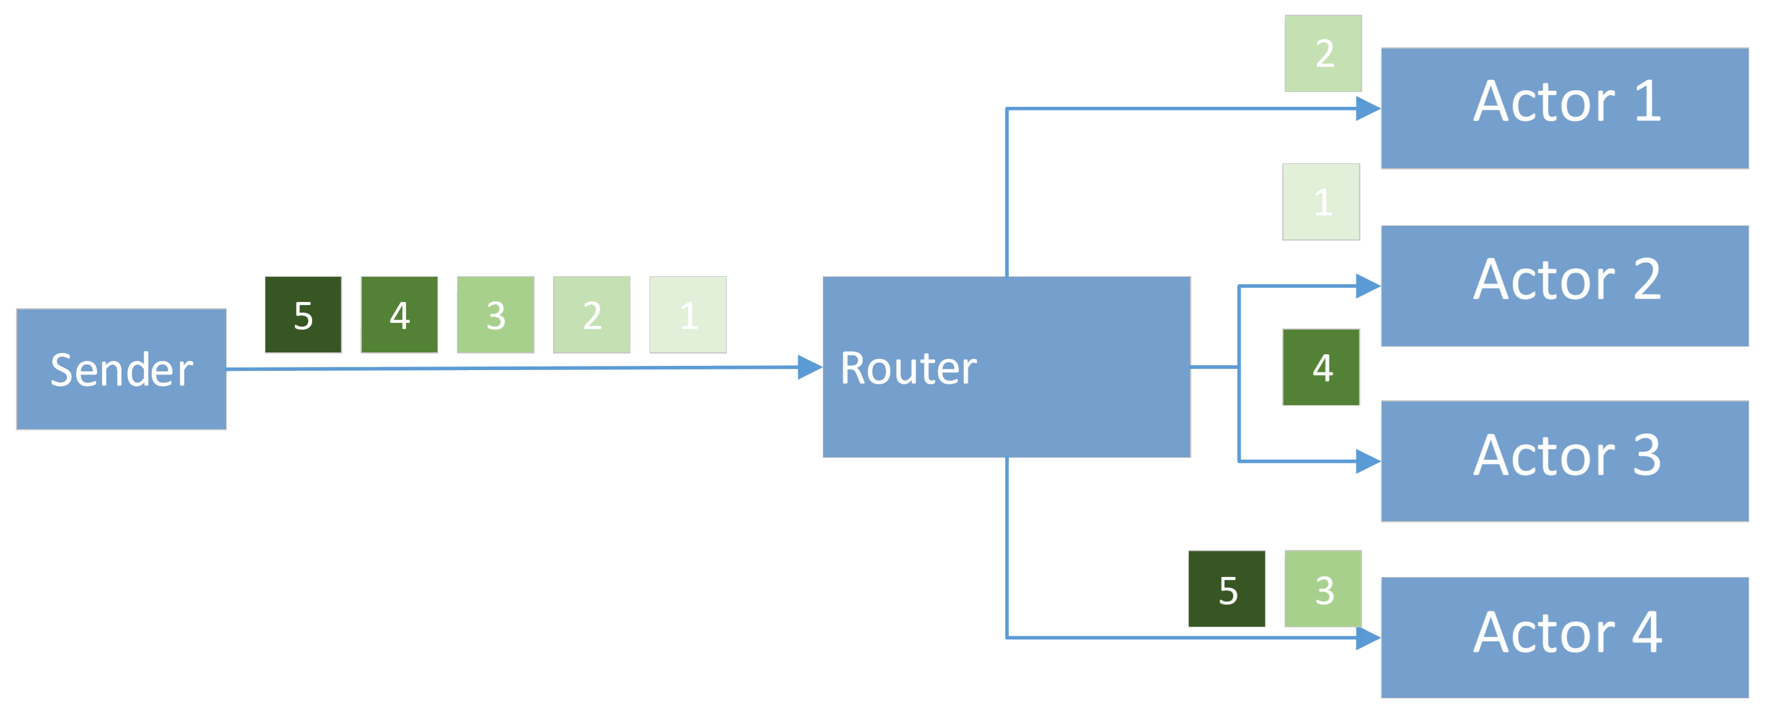
Routers
Special actor that groups other actors
Distribute message using strategy
Round robin
Random

Slide 18
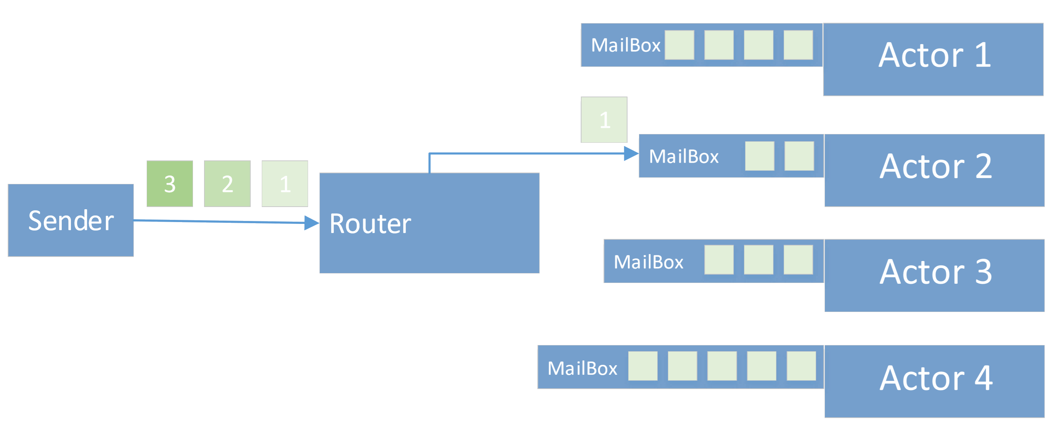
Routers
Special actor that groups other actors
Distribute message using strategy
Round robin
Random
Shortest Mailbox queue

Slide 19
Routers
Special actor that groups other actors
Distribute message using strategy
Round robin
Random
Shortest Mailbox queue
Consistent Hashing
Based on message property
All items with same value go to same actor
Notes:
Not ideal if 80% of data is going through 1 actor

Slide 20
Actor Path and Actor Selector
Unique path assigned on Actor creation
By code or auto-assigned (e.g. $a)
Path does always exist, no lifecycle like actor reference
akka://my-first-akka@localhost:8000/user/player-coordinator/Bart
Protocol: tcp by default or udp
Actor System: name of ActorSytem set on creation
Address: optional, set in case of remote deployments
Path: path of actor in hierarchy
Actor selection: absolute or relative paths
../../statistics

Slide 21
Demo: Hierarchy and Routing
Notes:
Demo 3: Hierarchy in console
+
Xamarin app Step 1 to 5
Timing +- 23 min bij start

Slide 22
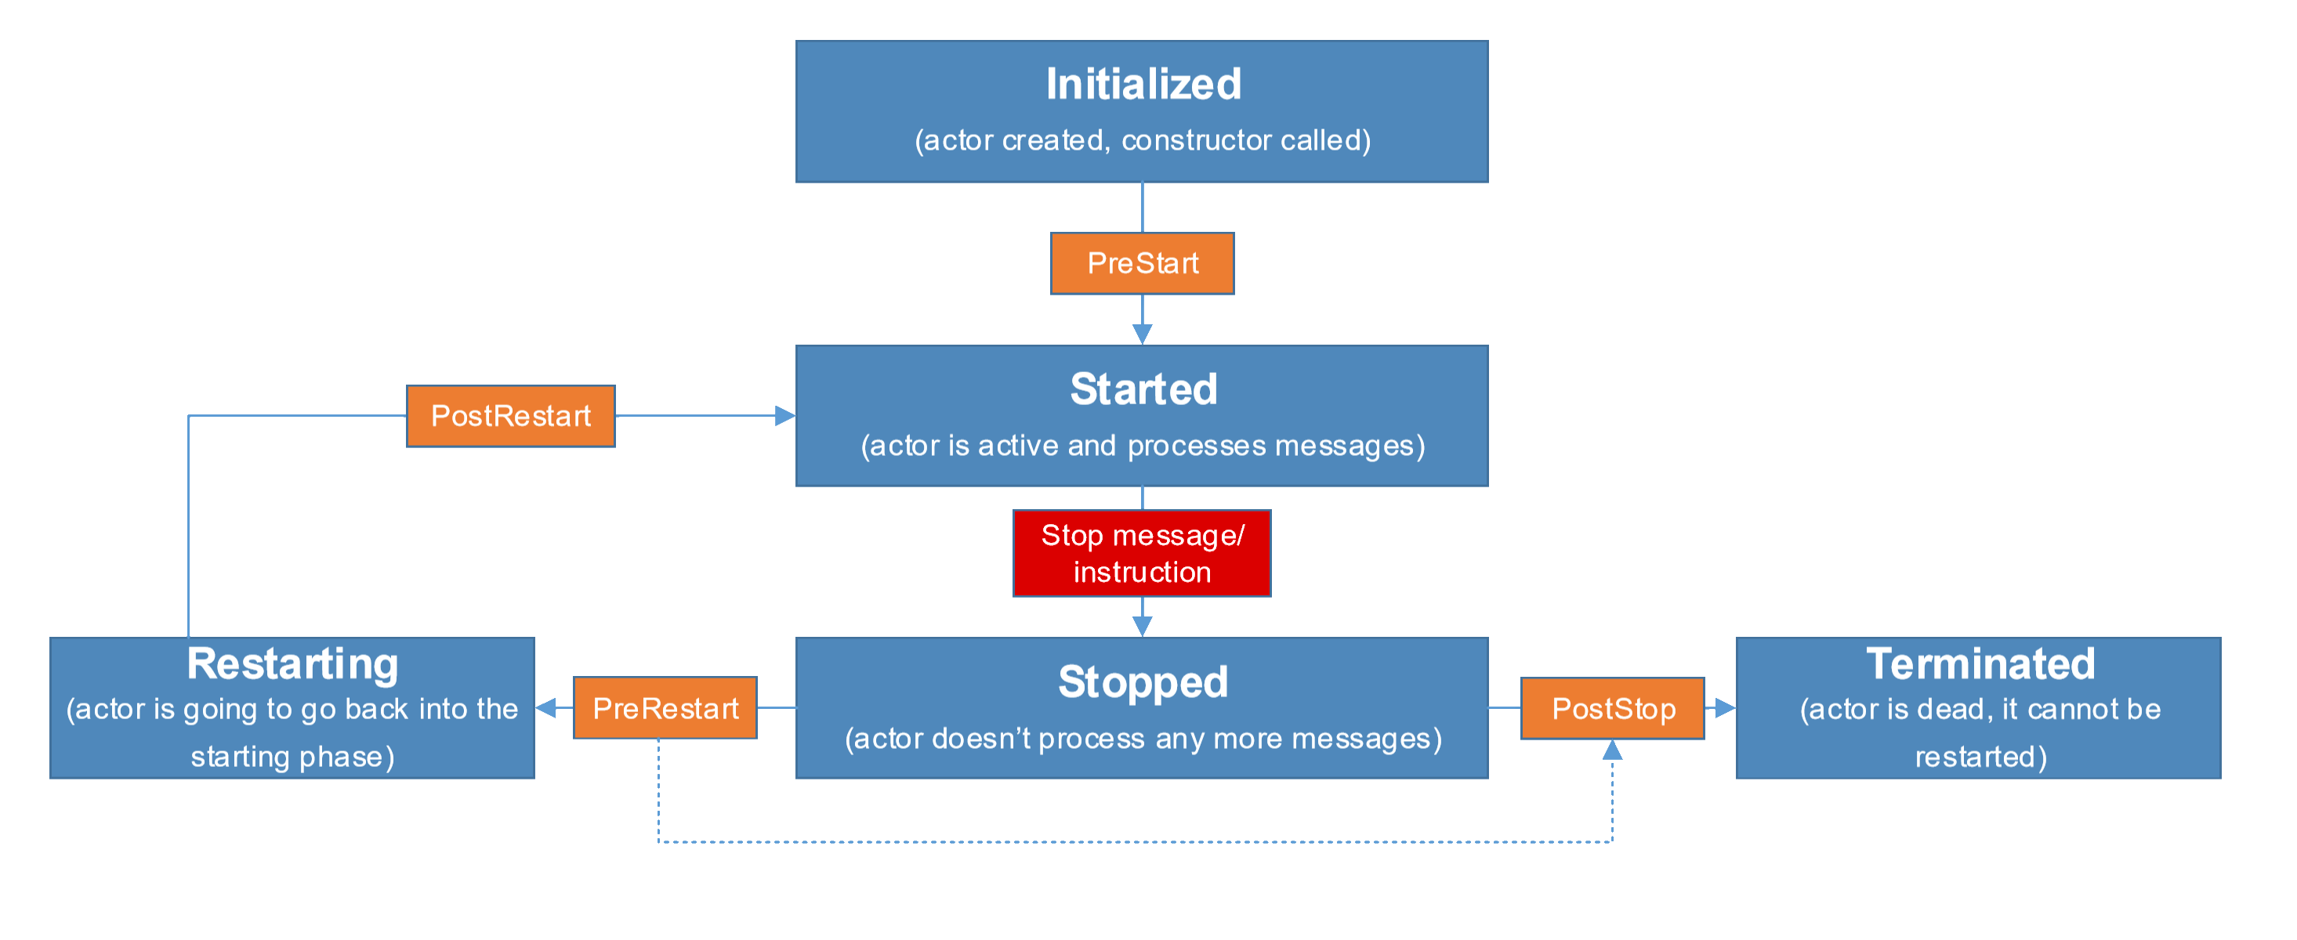
Actor Lifecycle and State
Notes:
PreStart: prep work to be done before receiving messages
Started: alive and ready to receive messages
PreRestart: if base method called, we go to PostStop => real restart: don’t call base method
PostStop: terminated, no way back
PostRestart: holds last exception message

Slide 23
Actor Lifecycle
Terminate
Terminate ActorSystem
ActorContext.Stop()
PoisonPill message
Kill message (throws ActorKilledException)
GracefulStop(Timespan span)
Deadletter: all messages arriving after kill
Restarting
Depends on Supervision Strategy
Notes:
.Stop(): finish current only
PoisonPill / Kill: finish whole queue
Graceful = PoisonPill with timer
Restarting: default: every exception thrown > restart

Slide 24
Demo: Lifecycle
Notes:
Demo Xamarin app Step 6 to 8

Slide 25
Other components (1)
EventBus
EventStream (pub/sub) in single ActorSystem context, not across node
Unit Testing
Akka.TestKit: TestKitBase
Akka.TestKit.NUnit, Akka.TestKit.XUnit, …
Logging
StandardOutLogger, BusLogging
Akka.Logger.Serilog, Akka.Logger.Nlog, …
Scheduling
ActorSystem.Scheduler
Notes:
Eventbus:
Default Tell/Forward = 1-1 communication .. One to many using pub/sub
Deadletter is also EventStream

Slide 26
Other components (2)
Circuit Breaker
Akka.Pattern.CircuitBreaker
Persistence
Event Sourcing: changes to internal state (default)
SnapshotStore: snapshot of current state
Remoting
Default: single ActorSystem = single application process
Multiple ActorSystems in different processes
Single machine
Another server
TCP: akka.tcp://actorsystemname@192.168.1.105:8000/user/a2
Notes:
Circuit Breaker: Extra stability and prevent cascading failures

Slide 27
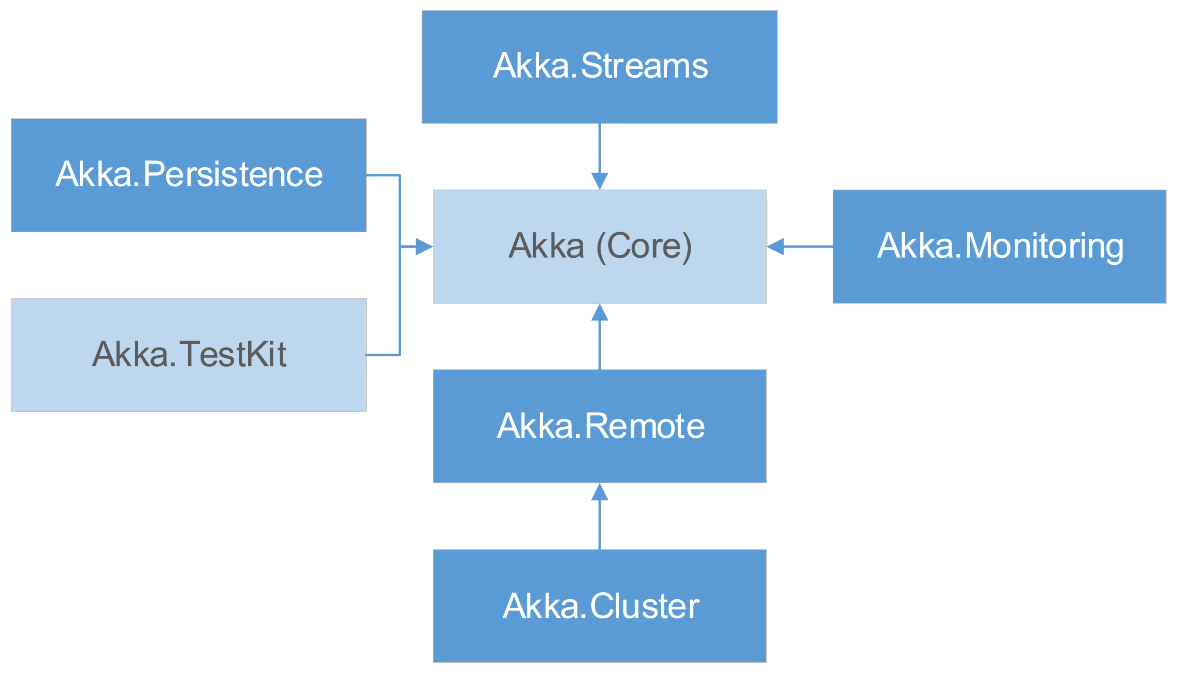
Akka.NET Components

Slide 28
What about Microsoft Orleans?
Microsoft Orleans | Akka.NET
Comes out of Microsoft Research | Port of Java/Scala Akka
Open Source | Open Source
TPL & Reactive Methodology | TPL & Reactive Methodology
Cloud-native | In-app, on-prem, in the cloud
Virtual Grain created on demand | Explicit created/stopped Actor
Grain needs an Id | Actor created in context of parent
 | Full lifecycle model
Focus on easy default behavior | Minimal abstraction required, so higher entry
=> Quick start into Actor model | => More expert at higher performance
Notes:
Both have
Async processing
Single threading
Storage
Messaging guarantees
…

Slide 29
Recap
Actor Model and Akka.NET
Actors and messages
Actor hierarchy and routing
Actor lifecycle

Slide 30

Thank you!
Bart Lannoeye
Senior .NET Consultant @ Sirus
Twitter: @bartlannoeye
Glenn Versweyveld
Mobile Developer @ Bank J.Van Breda & C°
Twitter: @depechie
https://github.com/Depechie/2018-Techorama-Akka

